Slide 1

Implementing our plan!
Thursday, August 13

Slide 2
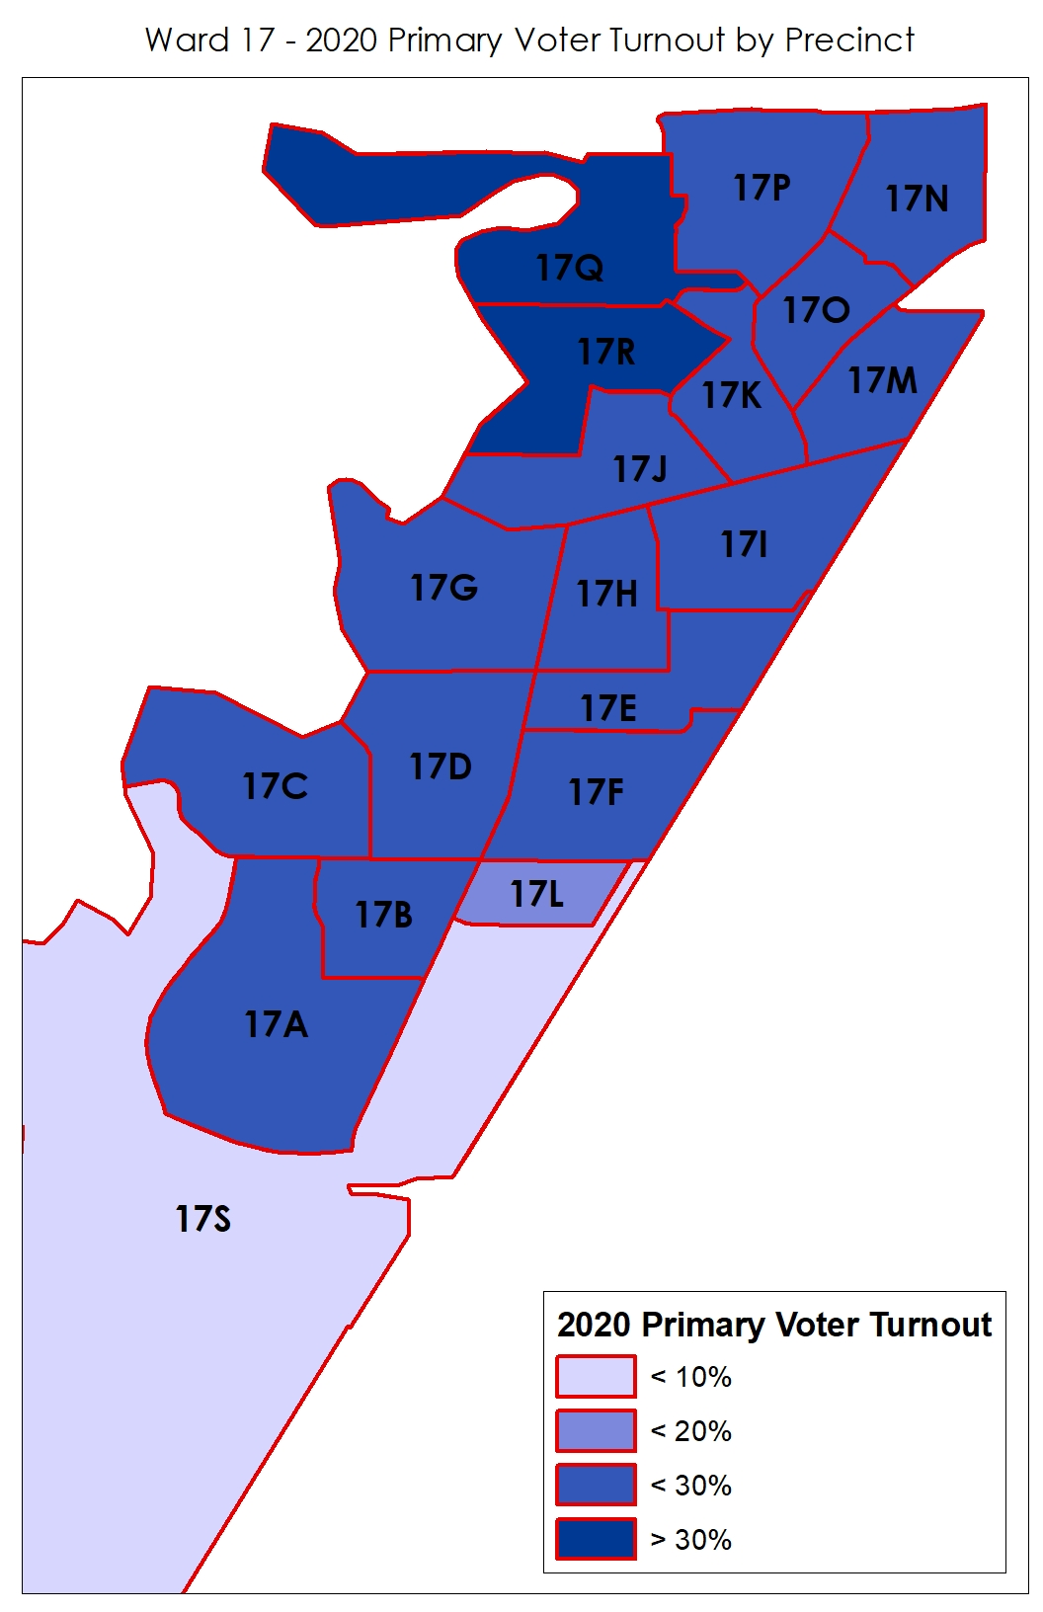
REMINDER: VOTER CONTACT GOALS
Ward 17 has 19 precincts;
Trying to reach 7,500 voters 3X in Ward -- registered Dem and Dem leaning independents; AND
Teaming up with Ward 16 to help support West Park wide GOTV efforts

Slide 3
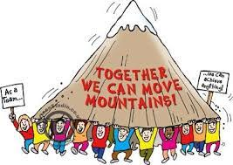
BUILDING OUR TEAM
Goal = Minimum
75 Volunteers

Slide 4
STATS …
ACTIVITY | NUMBERS
Vote By Mail (VBM) Kit Assembly | 40+ volunteers
VBM Deliveries | Saturday 8/8 = 22 volunteers Hit most of six (6) precincts w/exception of some apartments
Upcoming VBM Deliveries Upcoming | Saturday 8/15 = 31 committed volunteers Saturdays 8/22 & 8/29 looking for volunteers

Slide 5
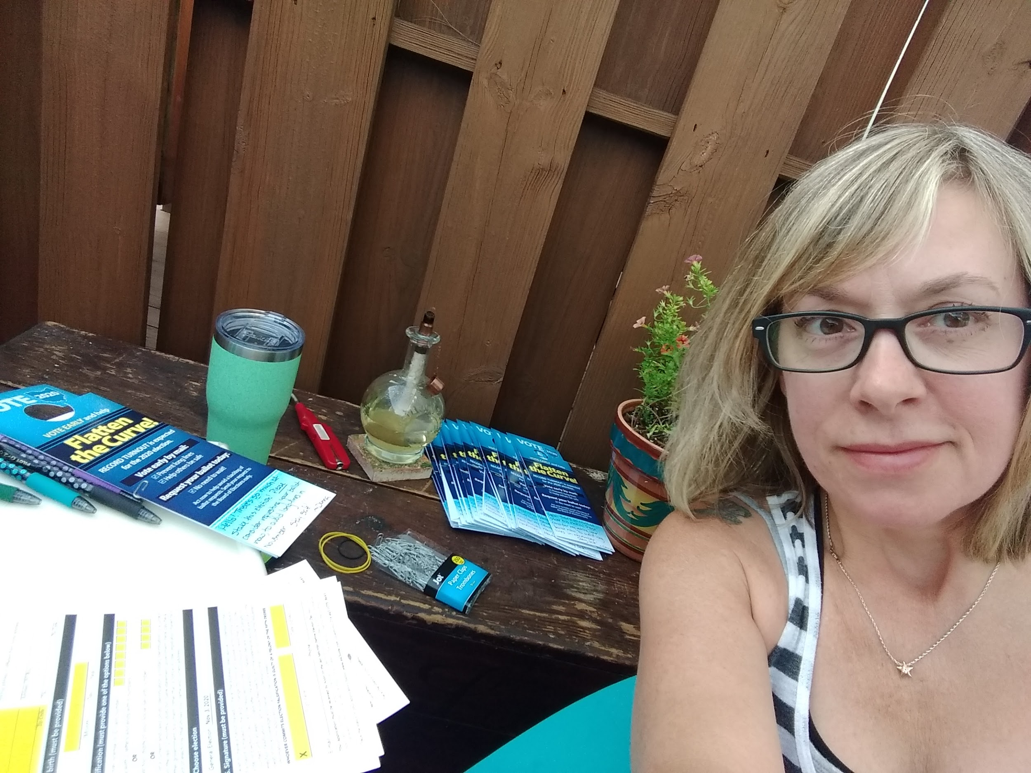
Notes:
New Club member Ashlynn’s daughter registers as our youngest volunteer and MVP for most assembled door hangers goes to Donna -- folks like Penny, Ed and Sharon and Murray and Margo aren’t far behind!

Slide 6
Notes:
Murray, Margo and Olivia getting the work done!

Slide 7
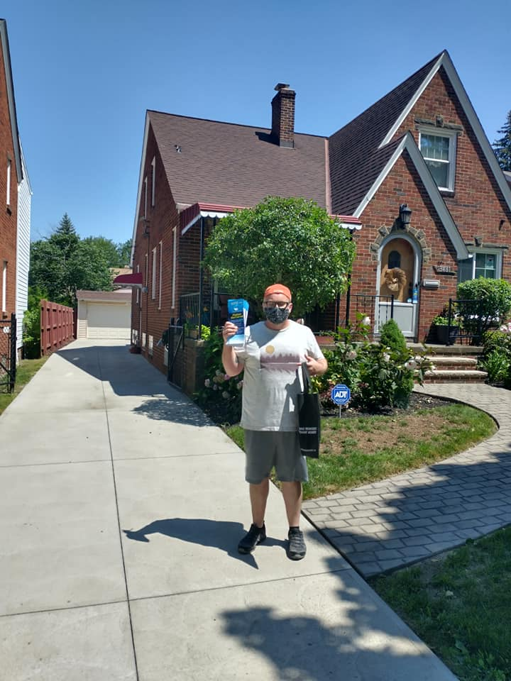
Notes:
Joe and Colleen who both helped with our primary postcard writing campaign are back at for the general

Slide 8
Notes:
Dana Buehner leading up a team of volunteers on the best street in West Park -- W. 148th.

Slide 9
How to I get involved?
If you want to help with the door hanger project, email Nora at norakelley@gmail.com.
If you’re interested in other volunteer opportunities, email Charlie at charles.j.slife@gmail.com.
And check out our Facebook Page for upcoming opportunities to get plugged in.

